Slide 1
Information Security
Ms. Ayesha jarral

Slide 2
What is Cryptography?
Cryptography (from Greek words meaning hidden writing) is the practice of transforming information so that it is secure and cannot be accessed by unauthorized parties.
This is accomplished through scrambling the information in such a way that only approved recipients can access it.
Whereas cryptography scrambles a message so that it cannot be understood, steganography hides the existence of the data.
What appears to be a harmless image can contain hidden data, usually some type of message, embedded within the image.
Notes:
Steganography typically takes the data, divides it into smaller pieces, and hides these in unused portions of the file.
Steganography may hide data the file header fields that describe the file, between sections of
the metadata (data that is used to describe the content or structure of the actual data), or in the areas of a file that contain the content itself.
Steganography can use a wide variety of file types image files, audio files, video files, etc.to hide messages and data.

Slide 3
Basic Terms
An original message is known as the plaintext, while the coded message is called the ciphertext.
The process of converting from plaintext to ciphertext is known as enciphering or encryption;
restoring the plaintext from the ciphertext is deciphering or decryption.
The many schemes used for encryption constitute the area of study known as cryptography. Such a scheme is known as a cryptographic system or a cipher.
Techniques used for deciphering message without any knowledge of the enciphering details fall into the area of cryptanalysis. Cryptanalysis is what the layperson calls “breaking the code.”
The areas of cryptography and cryptanalysis together are called cryptology.

Slide 4
Symmetric Cipher Model
A symmetric encryption scheme has five ingredients:
Plaintext: This is the original intelligible message or data that is fed into the algorithm as input.
Encryption algorithm: The encryption algorithm performs various substitutions and transformations on the plaintext.
Secret key: The secret key is also input to the encryption algorithm. The key is a value independent of the plaintext and of the algorithm. The algorithm will produce a different output depending on the specific key being used at the time. The exact substitutions and transformations performed by the algorithm depend on the key.
Ciphertext: This is the scrambled message produced as output. It depends on the plaintext and the secret key. For a given message, two different keys will produce two different ciphertexts. The ciphertext is an apparently random stream of data and, as it stands, is unintelligible.
Decryption algorithm: This is essentially the encryption algorithm run in reverse. It takes the ciphertext and the secret key and produces the original plaintext.

Slide 5
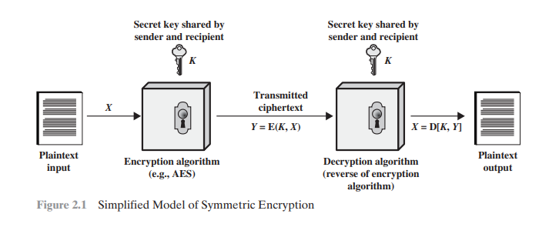

Slide 6
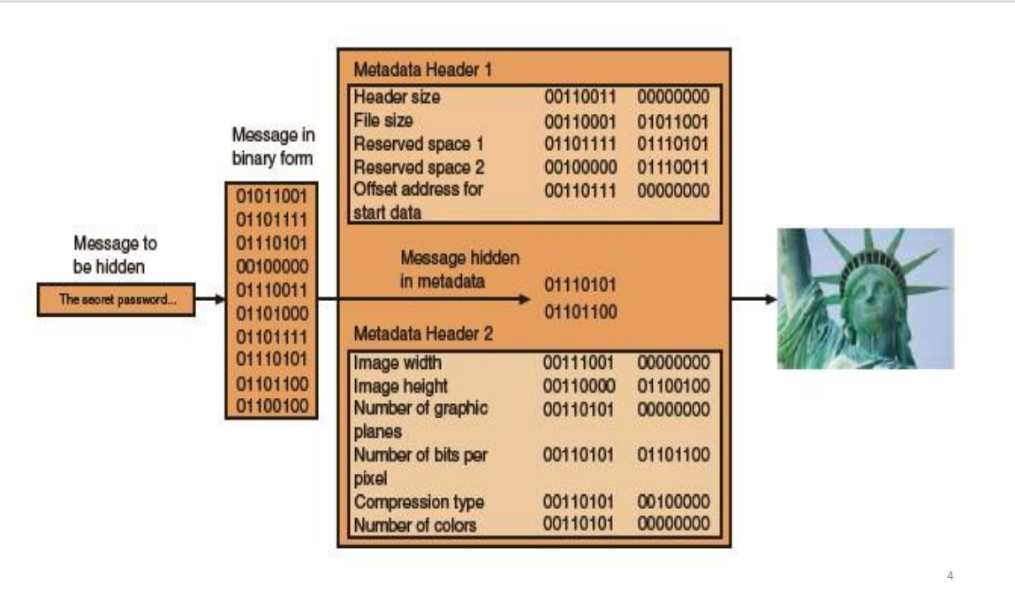

Slide 7
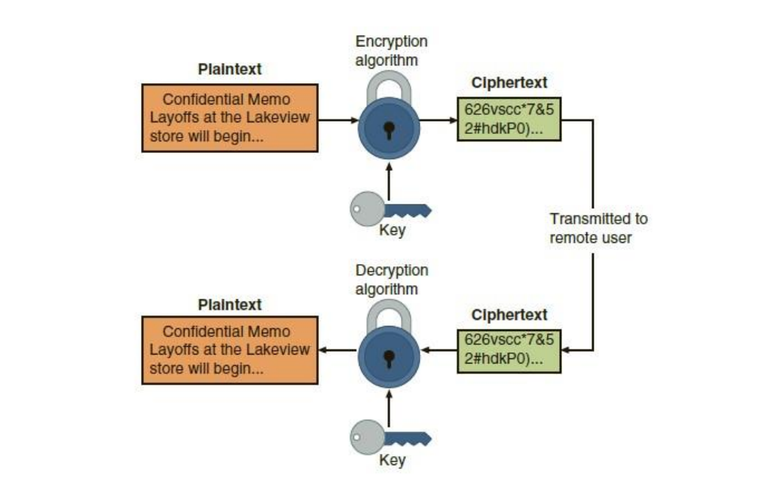

Slide 8
Cryptanalysis and Brute-force Attack
There are two general approaches to attacking a conventional encryption scheme.
Cryptanalysis: Cryptanalytic attacks rely on the nature of the algorithm plus
perhaps some knowledge of the general characteristics of the plaintext or
even some sample plaintext–ciphertext pairs.
Brute-force attack: The attacker tries every possible key on a piece of cipher
text until an intelligible translation into plaintext is obtained. On average, half
of all possible keys must be tried to achieve success.

Slide 9
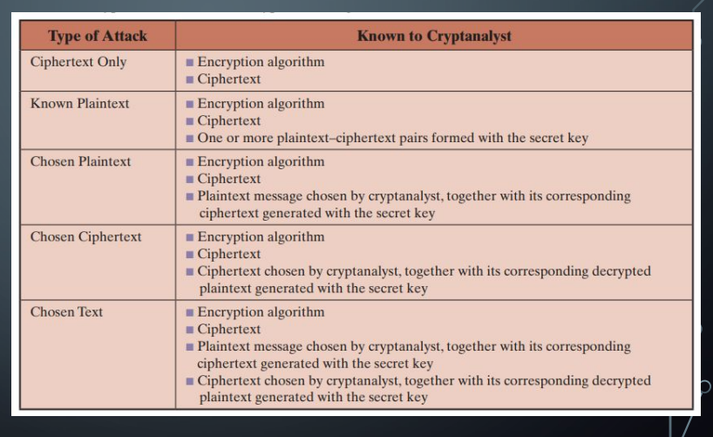
Cryptanalysis
The table summarizes the various types of cryptanalytic attacks based on the amount of information known to the cryptanalyst.

Slide 10
Thank you!

